Slide 1
Vietnam War Plane Crash Survivability
Background
US Air Force lost over 1,700 fixed-wing aircraft in combat from 1962 -1973 during the Vietnam War
Question
Using characteristics of each plane crash, can we predict whether the pilot survived or was killed in the crash?

Slide 2
Project Summary
Selected topic
An analysis of pilot survivability from U.S. aircraft combat losses during the Vietnam War.
Reason topic was selected
As a team we selected this topic because of our shared interest in historical events as well as the nature of the dataset itself. Our data sources provided many features we thought would make for an interesting story once we applied machine learning; notably key characteristics that have potential for influencing pilot survivability. We believe the challenges of analyzing this dataset give us the chance to showcase many of the skills we have learned throughout the course.
Description of the source of data
Our data sources are two websites dedicated to military aviation research, those being (https://www.aviationarchaeology.com/index.asp) and (https://www.vietnamairlosses.com/index.php). Each provided data on aircraft losses, such as crash date, pilot status, base, aircraft type, etc. However, our initial ML model is working solely off of aviationarchaeology.com since there is a more complete picture of the crash characteristics on this page. All data used was obtained through the use of web scraping techniques.
Questions the team hopes to answer with the data
Can looking at the characteristics of each warplane crash predict whether or not the pilot survived the crash. Our ML model will seek to predict whether a pilot survived or was killed based on particular crash features like aircraft type or what armament hit the plane, for example.

Slide 3
Project Outline
Supplemental info in CSVs
Website data sources
Dashboard in Tableau
Web scraping Jupyter file
PostgreSQL database
ETL Jupyter file
Supervised ML model

Slide 4
Data Exploration
Our raw data was first scraped using the BeautifulSoup library in Pandas.
The data pulled from the web needed a lot of work to become useable:
Splitting the data into multiple columns
Removing rows with missing data
Converting certain string fields to integers, datetime
Converting location data into decimal degrees format
Some quick visuals and count checks were created for the characteristics/fields believed to have the most predictive influence on survivability
A major challenge was the incompleteness of some fields within the dataset.

Slide 5
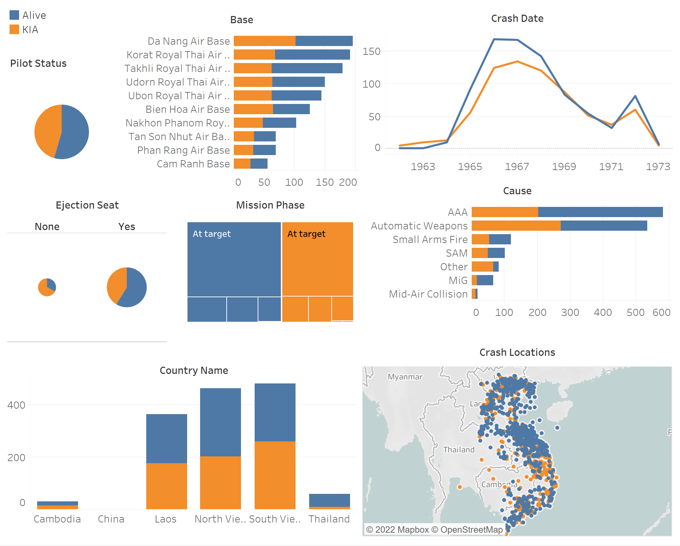
Initial Exploration Dashboard:

Slide 6
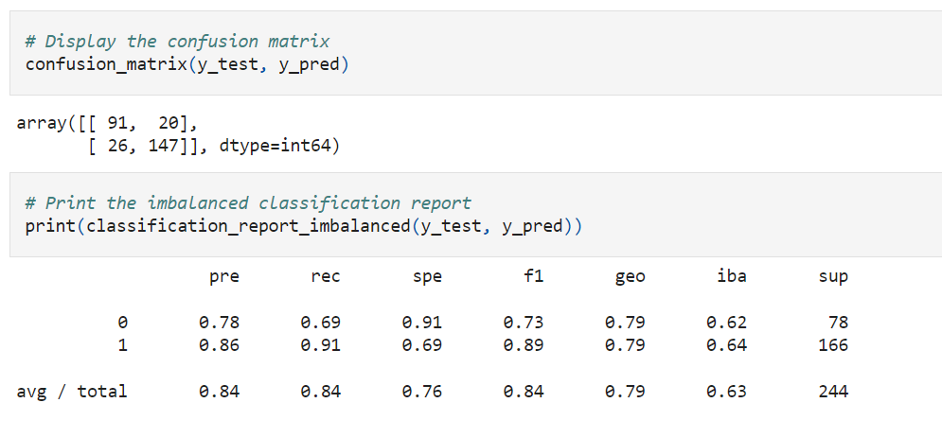
Data Analysis
For our analysis, we asked the question can plane attributes, location and artillery features be predictive of plane crash fatalities. Utilizing web scraping, the total population of plane crashes during the Vietnam War was collected.
Our question, lends itself to supervised ML models meant to predict outcomes, such as logistic regression and ensemble models.
During our analysis phase all supervised ml models and learned sampling techniques from class were tested. In our initial draft Random Forest models yielded the highest accuracy.
Further refinements included, the addition of new variables from our database, “Ejection Seat (Y/N)”, bucketed aircraft types and defense types, and Latitude and Longitude. These changes reduced the amount of encoded features.
This is important as one limiting factor for our analysis, is that it heavily relies on categorical variables which may limit the power of our model.
With the addition of Latitude and Longitude other geographic variables such as “Base Name” and “Mission Phase” were removed due to there duplicative nature. Moreover Lat and Lon were preferred due to their integer data type.
With the additional data cleaning and features our ML model improved accuracy from 60% (Draft) to 84%.

Slide 7
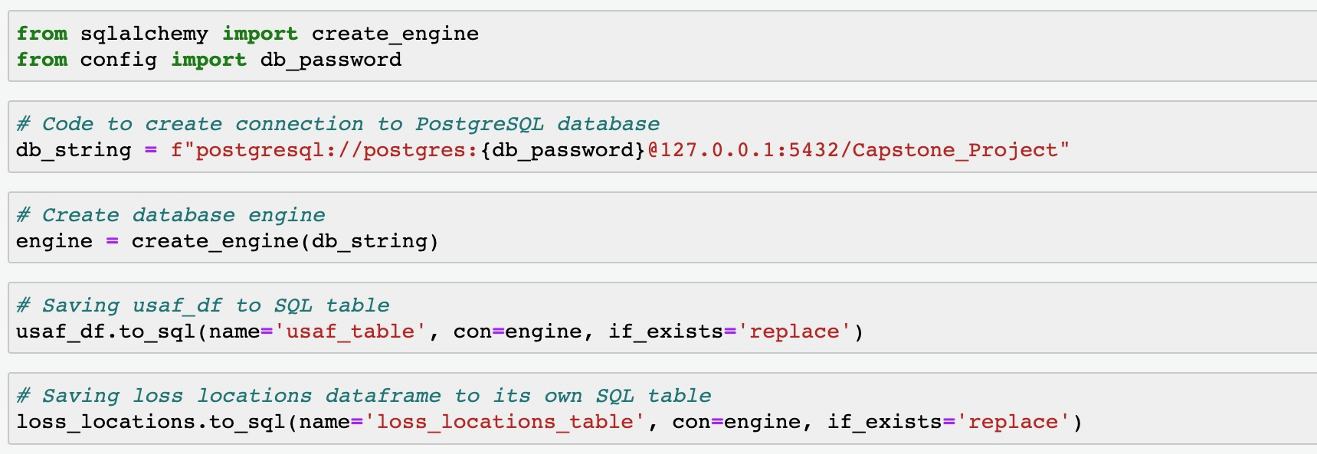
PostgreSQL Database
Connection String Using SQLAlchemy:
Connected cleaned usaf_df and additional supplemental data frame, loss_locations to pgAdmin from ETL file

Slide 8
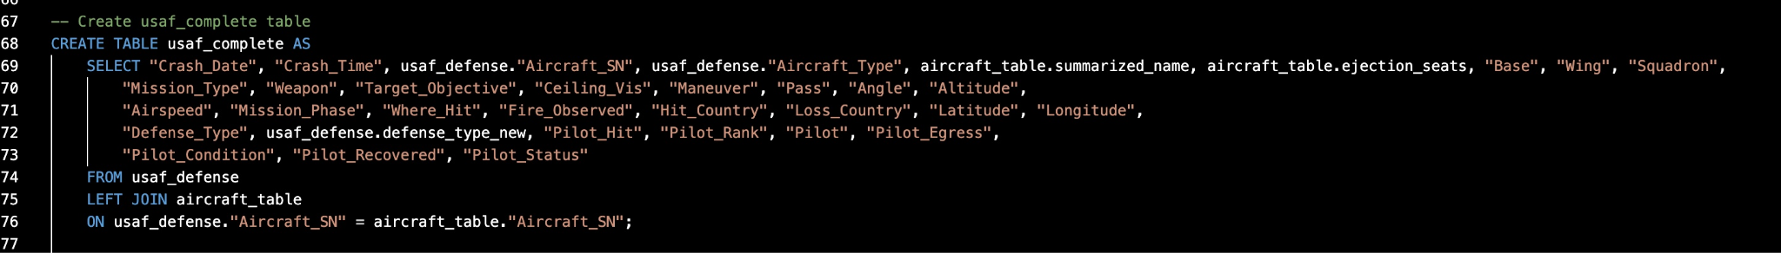
PostgreSQL Database
Joins:
Three Joins were made to create the usaf_complete table
Join on aircraft_information & usaf_table to create aircraft_table
Join on usaf_table & defense_type table to create usaf_defense table
Join usaf_defense & aircraft_table to create the usaf_complete table

Slide 9
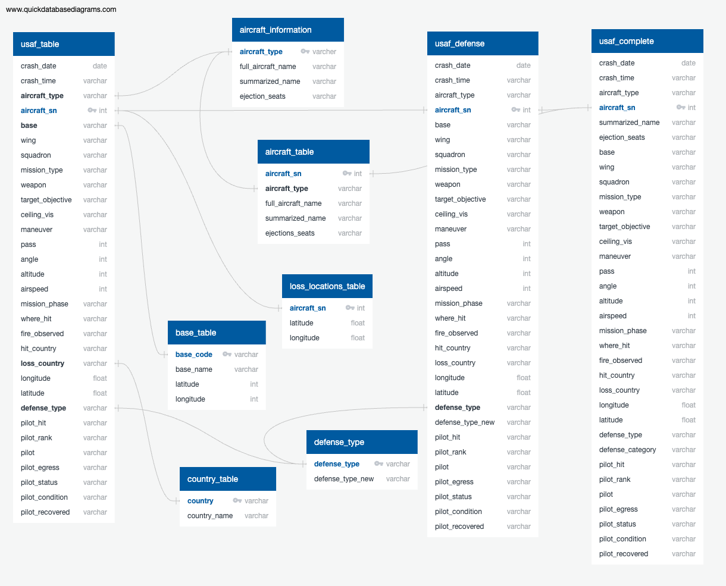
PostgreSQL Database

Slide 10
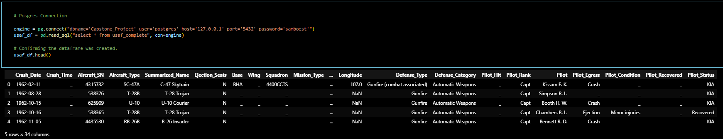
PostgreSQL Database
Database Interface: Connecting Postgres to ML model

Slide 11
Dashboard
Tools used:
Tableau will the primary tool
Exploring using Leaflet for an interactive map
Exploring using Streamlit/Google Data Studio for another interactive visual
Storyboard:
Intro: Description of our project and data | Gif of map showing crash locations by year | Mission characteristics dashboard Crash Date Cause Base Mission phase | Plane characteristics dashboard Aircraft Type Ejection Seat | ML model findings | Final interactive map

Slide 12
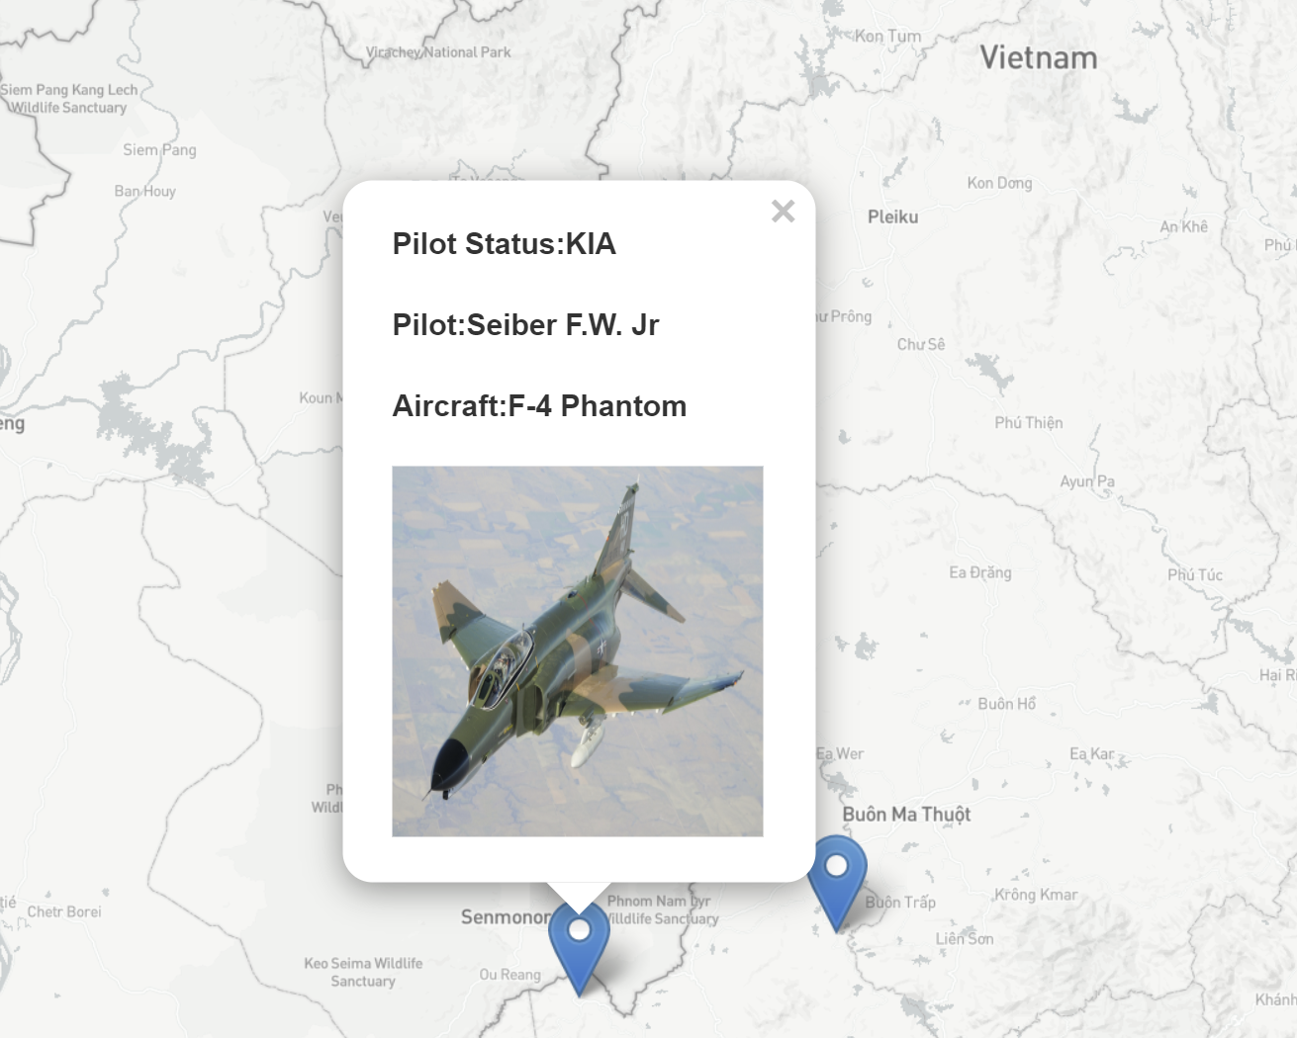
Dashboard: interactive elements
An interactive map where users can select a crash location and see key crash info and a picture of the plane involved.
Exploring using Leaflet for this

